Slide 1
AWS – PART IV
DevOps Course

Slide 2
Objectives
By the end of this session you’ll gain
CloudFormation Basics

Slide 3
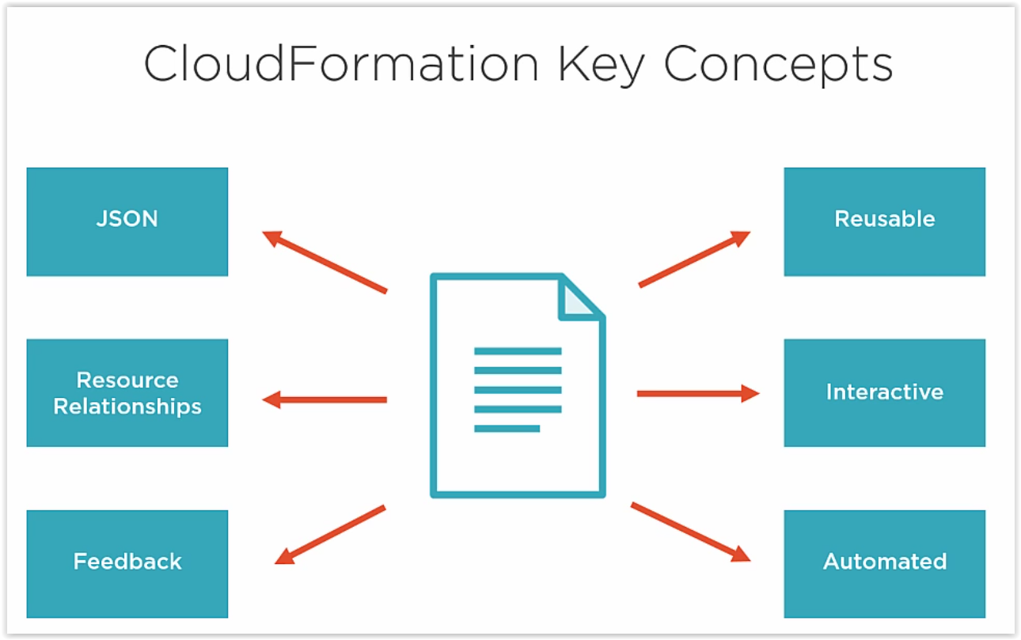

Slide 4
Cloud Formation Basic DEMO TIME

Slide 5
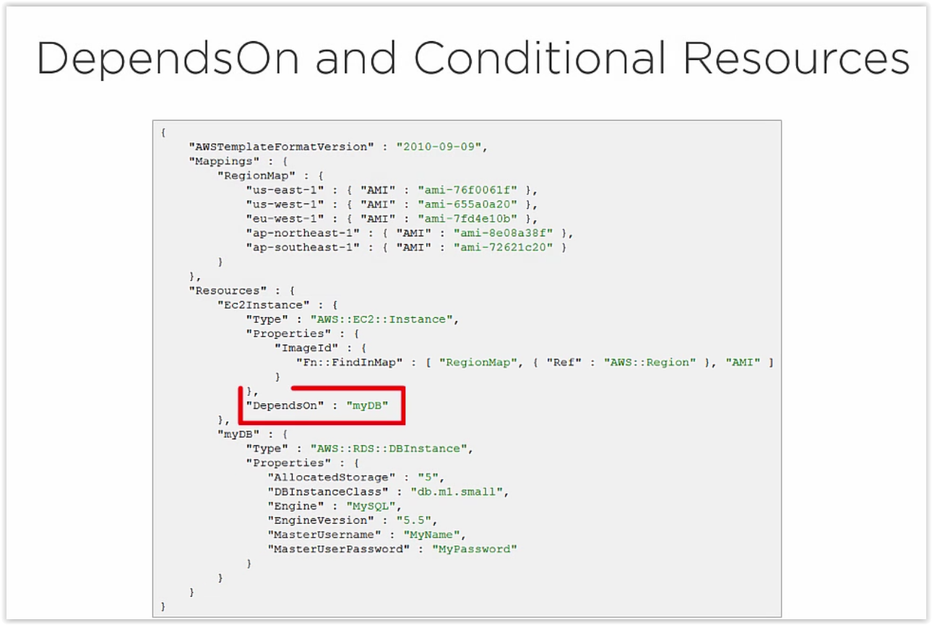

Slide 6
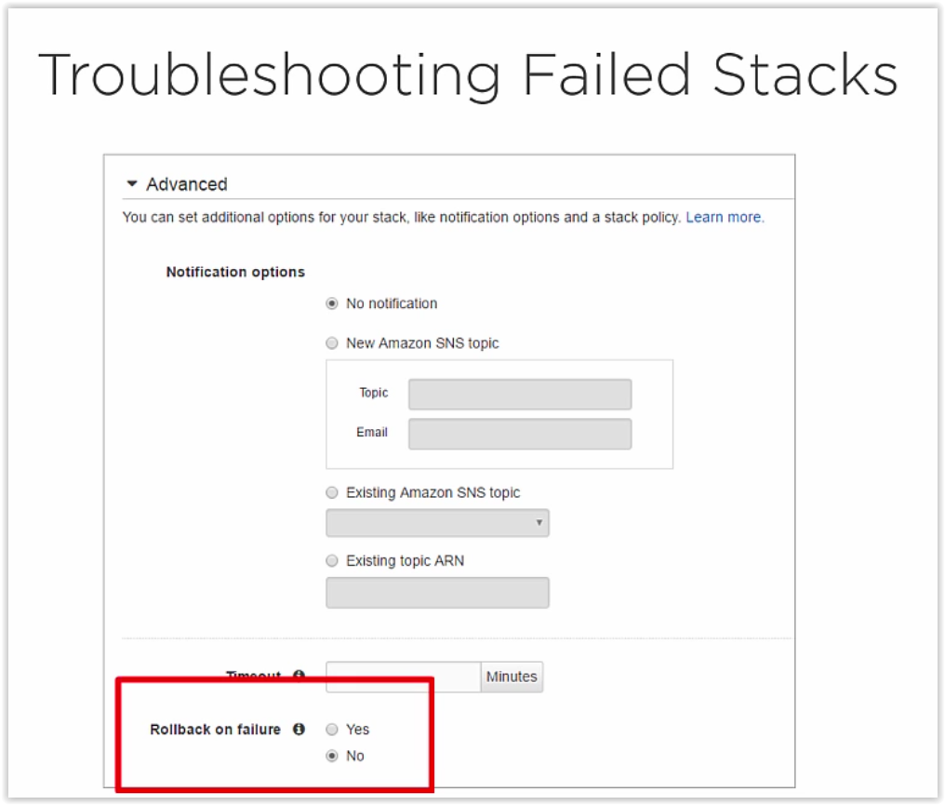

Slide 7
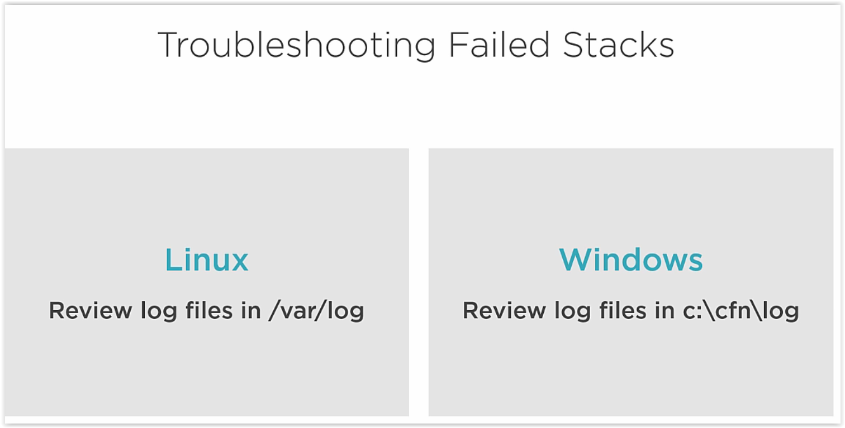

Slide 8
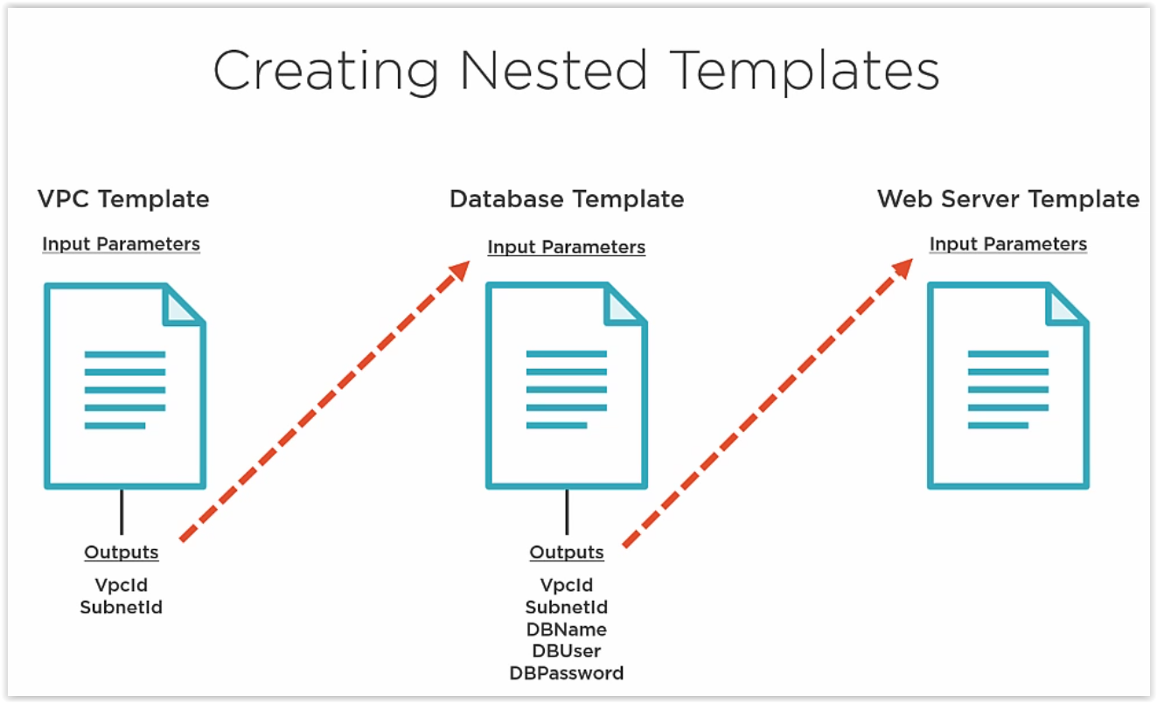

Slide 9
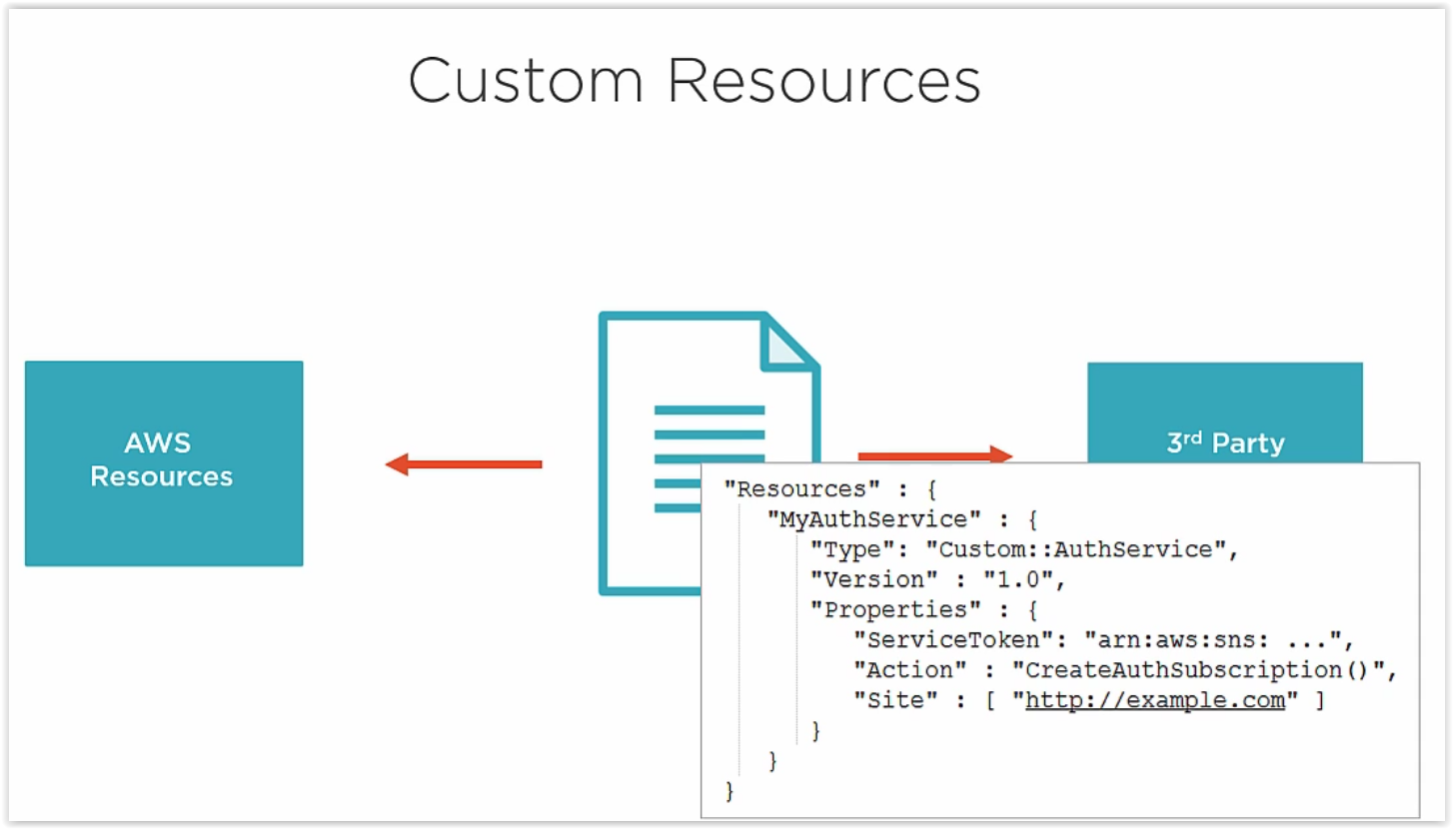

Slide 10
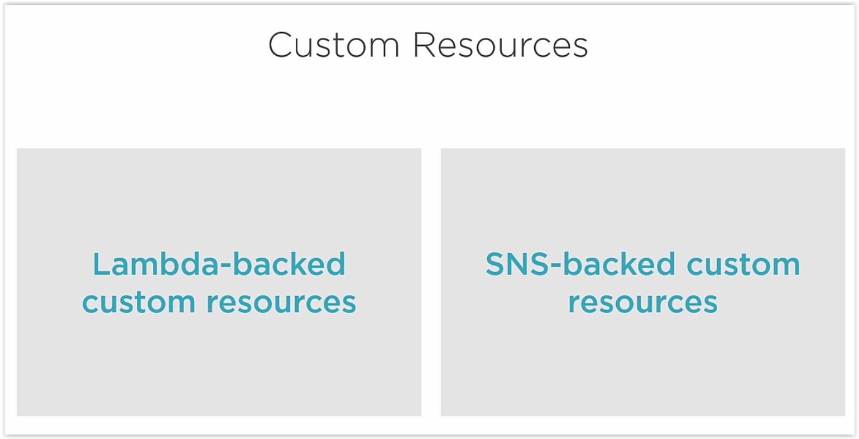

Slide 11
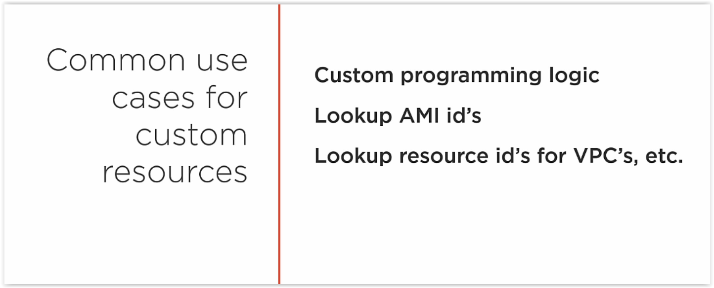

Slide 12
